Slide 1

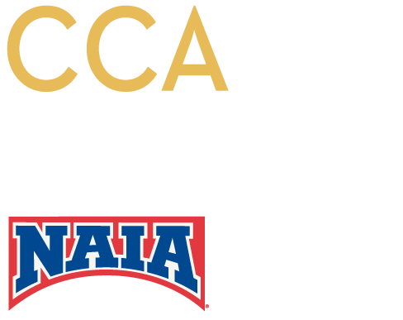
SEPTEMBER 2015 • KANSAS CITY, MO
Notes:
The necessity of a presence on at least some of the platforms
Target audience expects you to be there
If not there, seen as out of touch and outdated

Slide 2
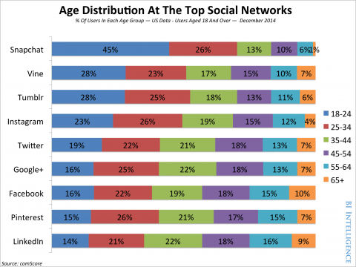
Social Media for NAIA Conferences
Younger social media users (18-24) place importance on visual platforms
Notes:
ANGELA
GOAL: Looking at the expectations of their target audiences … how they best reach them.

Slide 3
Photos, infographics & video are key
Notes:
ANGELA
GOAL: Importance of visual platforms … how to best engage visually

Slide 4
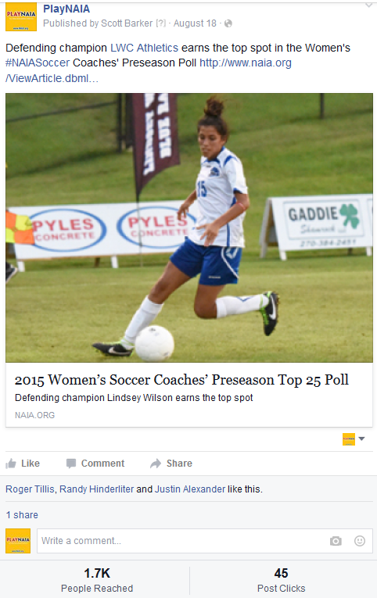
Notes:
ANGELA
Video = more than double the reach, a dozen more shares, 5 times the likes, almost 7 times the post clicks.

Slide 5
Most important social networks for teens and young millennials
Instagram is taking the place of Facebook and Twitter for young people
  Instagram = 32%
  Twitter = 24%
  Facebook = 14%
  Snapchat = 13% (and increasing rapidly)
Notes:
ANGELA
GOAL: Diving more specifically into the social media networks that their audience is going to be on.

Slide 6
Most important social networks for teens and young millennials
Facebook’s user base:
  38% under the age of 35
  43% over the age of 45
60% of time spent on all social media is on a phone or tablet
Notes:
ANGELA
GOAL: Diving more specifically into the social media networks that their audience is going to be on.

Slide 7
Measuring ROI on Social Media
Set social media goals
Determine the “right” platforms
Track campaigns
Review results and reset goals
Notes:
ALAN
Measuring Social Media ROI
Set social media goals
Determine the “right” platforms
Track campaigns
Review results and reset goals
Setting social media goals
- Identify how these fit within your overall conference marketing goals
- Identify what your current social media strengths are … maybe you’re good at Twitter, but not Facebook
- Choose something measurable … if you can’t measure them how do you know if you’ve accomplished them
- Make it attainable

Slide 8
Determine the “right” platforms
Notes:
ALAN
An overview of the major social media platforms that are out there today. Many of these are managed by someone in your office already

Slide 9
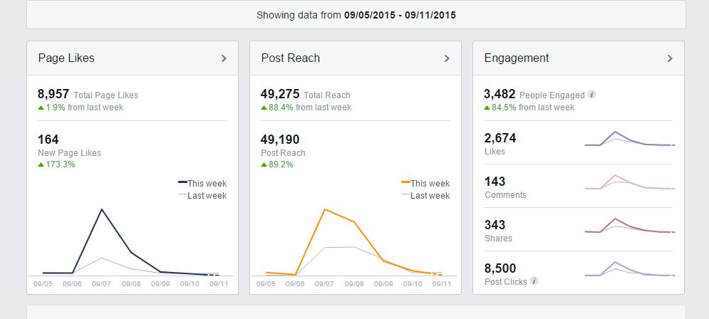

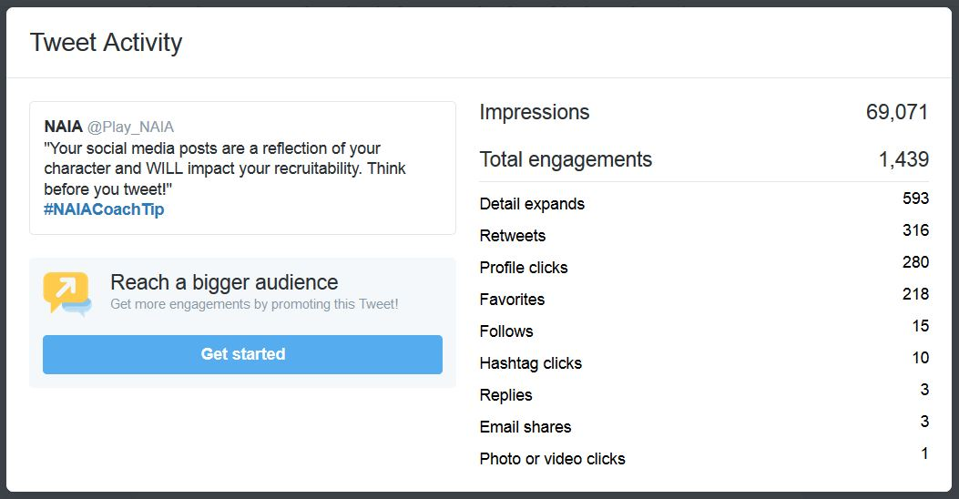

Social Media Tracking/Analytics
Notes:
ALAN
GOAL: Inexpensive options for measuring.
Hootsuite – Pro version is $9.99 per month

Slide 10
What can your conference do?
Determine your audience for each platform you maintain, then target your posts
Avoid text-heavy posts – include a visual whenever possible (all platforms)
Avoid linking to YouTube on Facebook – upload the video natively
Request verification of your Facebook page
Notes:
ALAN

Slide 11
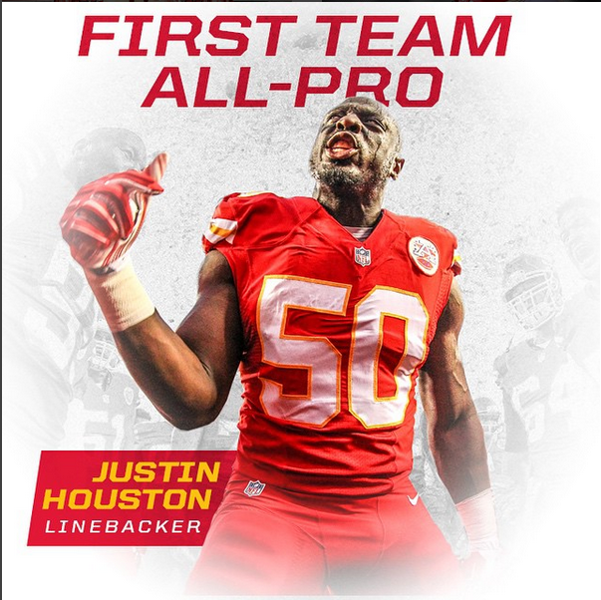
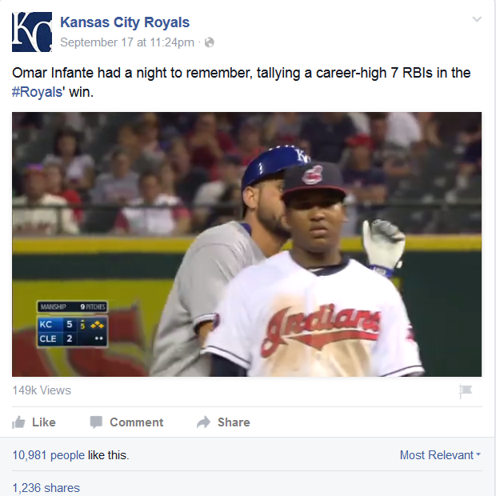
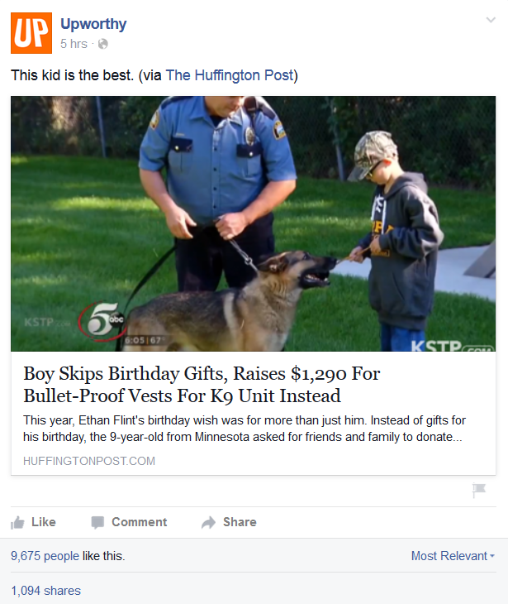
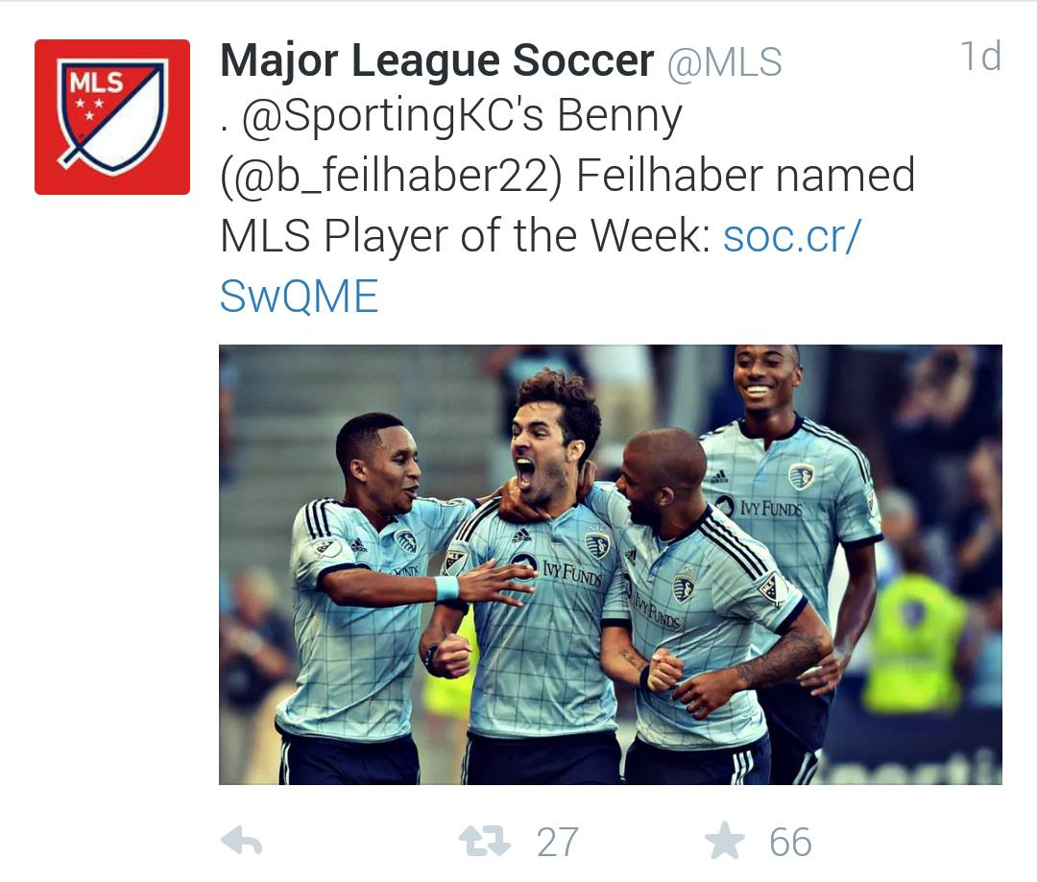
Notes:
ANGELA
Infographics on Instagram should limit use of text – focus on great images
Facebook posts with videos uploaded directly (not linked from YouTube) perform better
Keep tweets/FB posts/IG captions brief. Make captions fun and engaging.
Use images with a 2:1 ratio on Twitter
Lots of online resources for image sizes on each platform.

Slide 12

Incorporating Snapchat
Game day scavenger hunts or “screenshot to win”
Track analytics manually
Promote your username and snapcode frequently!
Notes:
ANGELA

Slide 13
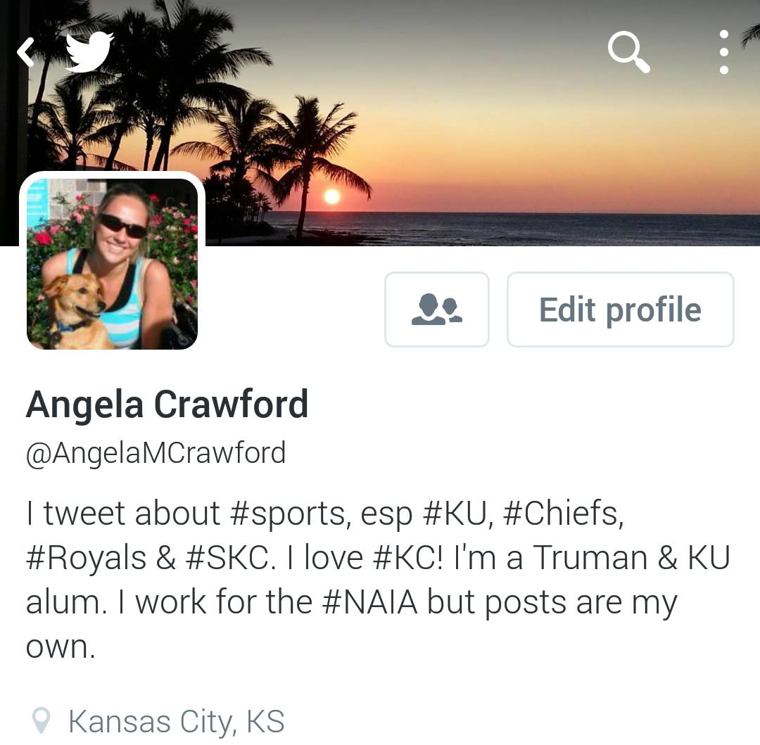
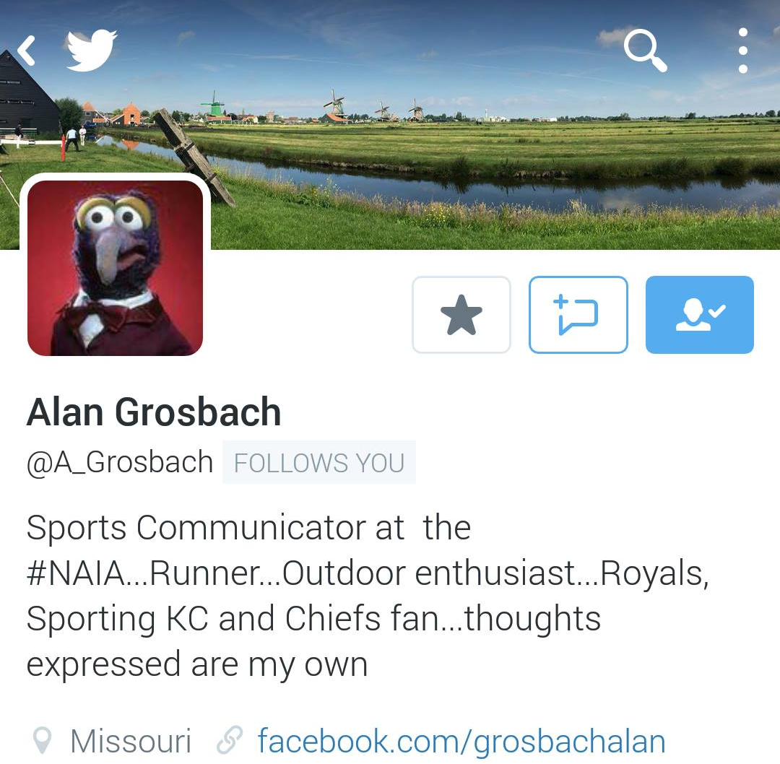
Questions?
Notes:
Both of us! (but mostly Angela)

